Slide 1
The Effect of Treatment on The Gene Expression

Slide 2
The linear relationship between concentration and gene expression

Slide 3
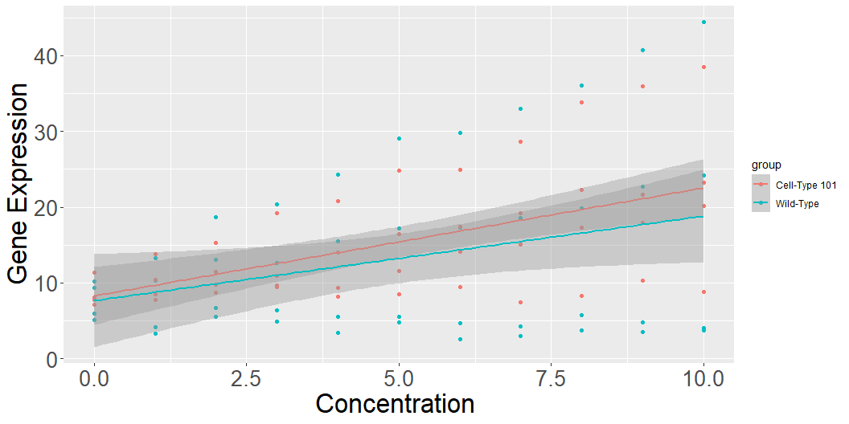
Grouped by Cell_line

Slide 4
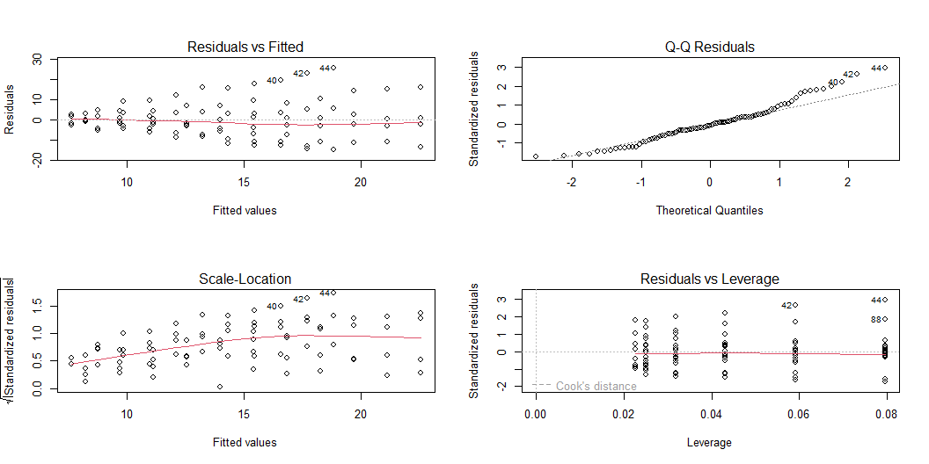
Grouped by Cell_line (the diagnosis of linear model)

Slide 5
Grouped by Cell_line (the result of linear model)
term | estimate | std.error | statistic | p.value
(Intercept) | 8.27 | 2.52 | 3.27 | 1.54 × 10⁻³
conc | 1.43 | 0.43 | 3.34 | 1.24 × 10⁻³
cell_lineWild-Type | −0.63 | 3.57 | −0.18 | 8.61 × 10⁻¹
conc:cell_lineWild-Type | −0.31 | 0.60 | −0.51 | 6.08 × 10⁻¹

Slide 6
Grouped by Cell_line
-It shows that cell_line does not significantly effect on the gene expression. -However, it may have a significant influence on the effect of treatment.

Slide 7
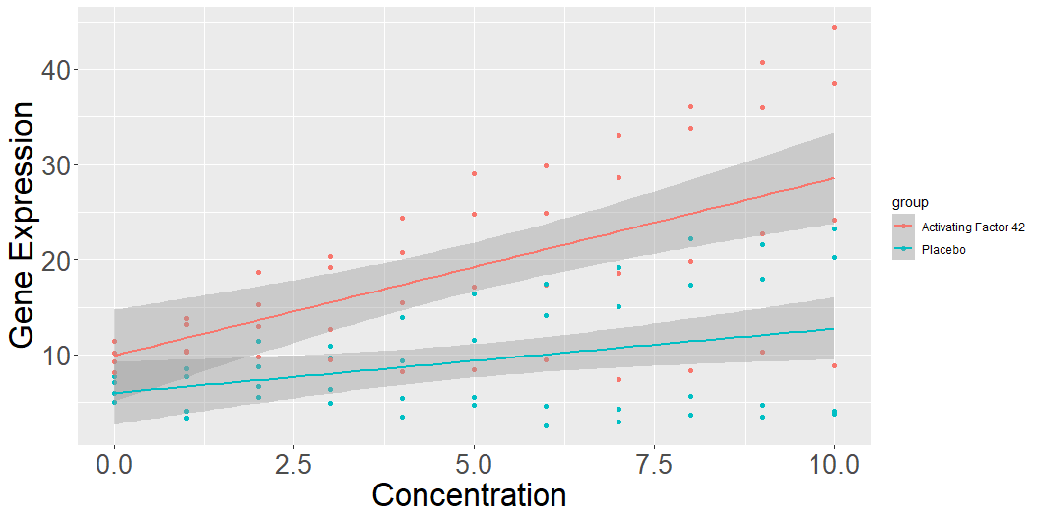
Grouped by Treatment

Slide 8
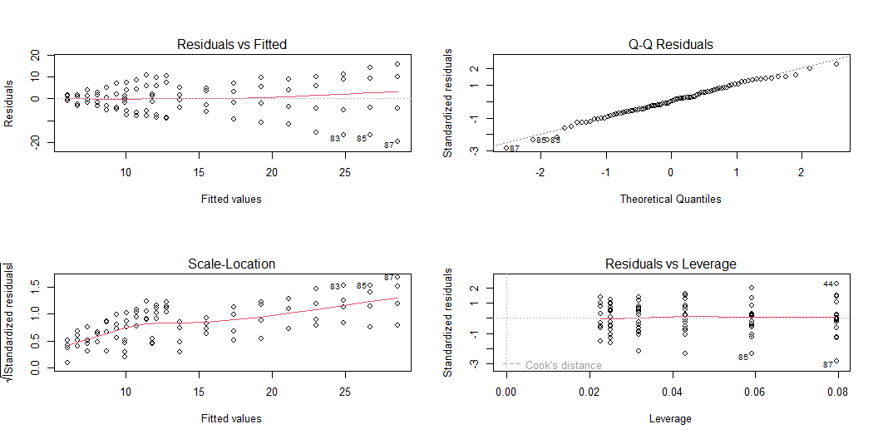
Grouped by Treatment (the diagnosis of linear model)

Slide 9
Grouped by Treatment (the result of linear model)
term | estimate | std.error | statistic | p.value
(Intercept) | 8.27 | 2.52 | 3.27 | 1.54 × 10⁻³
conc | 1.43 | 0.43 | 3.34 | 1.24 × 10⁻³
cell_lineWild-Type | −0.63 | 3.57 | −0.18 | 8.61 × 10⁻¹
conc:cell_lineWild-Type | −0.31 | 0.60 | −0.51 | 6.08 × 10⁻¹

Slide 10
Grouped by Case
Case is a new factor which is consist of information from cell_line and treatment.
For example, if a sample’s cell_line is wild-type and its treatment is placebo, its case will be wild-type&placebo.

Slide 11
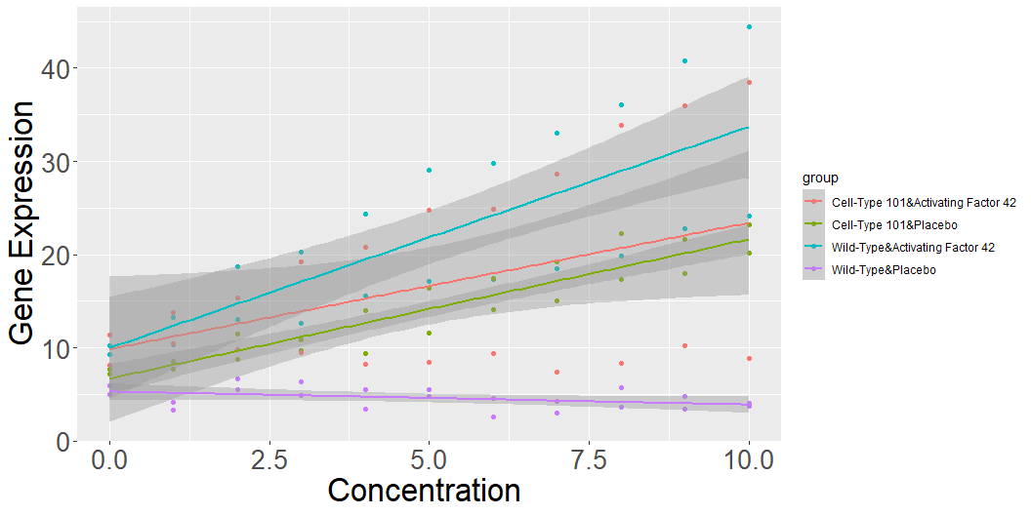
Grouped by Case

Slide 12
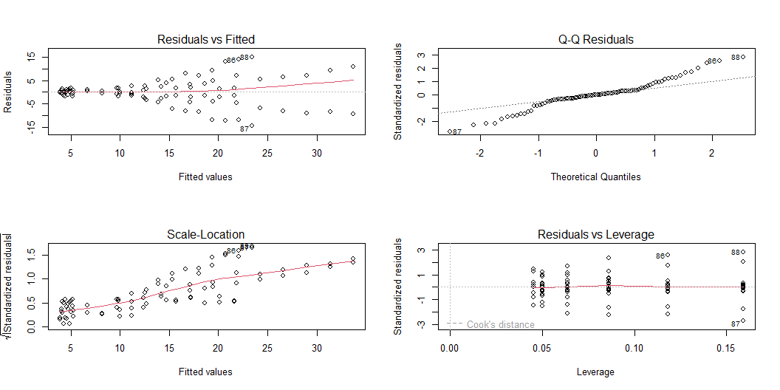
Grouped by Case (the diagnosis of linear model)

Slide 13
Grouped by Case (the result of linear model)
term | estimate | std.error | statistic | p.value
(Intercept) | 8.27 | 2.52 | 3.27 | 1.54 × 10⁻³
conc | 1.43 | 0.43 | 3.34 | 1.24 × 10⁻³
cell_lineWild-Type | −0.63 | 3.57 | −0.18 | 8.61 × 10⁻¹
conc:cell_lineWild-Type | −0.31 | 0.60 | −0.51 | 6.08 × 10⁻¹

Slide 14
Conclusion
The treatment only effects on the slope of gene expression.
The Activating Factor will amplify the effort of concentration on gene expression.
The Activating Factor (one of treatment) has significant influence on the Wild-Type while it does not work significantly on the Cell-Type 101.

